Slide 1
WELCOME TO OUR PROJECT PRESENTATION
Name: Momin Khan
Roll No: MOP-01009
Session: 2020-21
Date: 12-09-2024

Slide 2
PROJECT NAME: MICROSOFT OFFICE PROGRAMME
Sections of the project –
Microsoft Word
Microsoft Power point
Microsoft Excel
Objectives of the Project
To learn about how to make a assignment
To learn about how to make a presentation slide
To learn about how to make a excel task

Slide 3
Section:1 – Microsoft Word (1)
Number Of the class- 6
Class -1: All about basic of Computer, Input and Output, Create a folder etc.
Class-2: Internet, E-mail, Video or Music , Text chatting etc.
Class-3: Typing the text, alignment, copy, paste, Select all, Clear, etc.
Class-4: New, Open, Close, Save, Save as, etc.
Class-5: Shapes, Word Smart, Smart Art etc.
Class -6: Inserting Custom Header and Footer, inserting Objectives etc.

Slide 4
Section:2- Microsoft Word (2)
Number Of class – 6
Class-1 : Numbering List , Creating list , Page boarding , background etc.
Class-2: Table style, Alignment, merge , splits etc.
Class-3:Reference, endnote etc.
Class-4: Typing new address list, preview result , Setting rules.
class-5: Field, print, set up etc.
Class -6: Document, managing template etc.

Slide 5
Section:3- Microsoft Excel
Number of class – 4
Topic that discussed-
Basics of excel, row and columns
Merge and center, currency, Date and time, Text , Front Size.
Custom Filtering , Text filter, Chart styles.
Conditional formation, Editing chart and changing chart.

Slide 6
Section:4 – Power Point
Number of Class – 5
Class (1) – New, Open , Save, Save as, Copy, Paste, Cut etc.
Class(2)- Adding new slide , Duplicate Slide, Slide background etc.
Class (3)-Creating list, Page bordering, Alignment Text, Text directions, Inserting Text box, Inserting Art, Adding Picture, Adding table, Video clip, Audio clip, etc.
Class (4)- Animations, Rehearse timing, Creating Custom slide, Start Slide show, Check spelling, Print Preview, Smart Art etc.
Making a project presentation.

Slide 7
Bullets and Number Lists
Momin Khan
Shaikat
Ankon
Tanmoy
Mehedi
Abu Bakkar
Limon
Mamun
Kajol

Slide 8
Animations
Animation is a technique used to create the illusion of movement by displaying a series of individual frames or images in rapid succession. Here is some e4xamples of Animations –

Slide 9
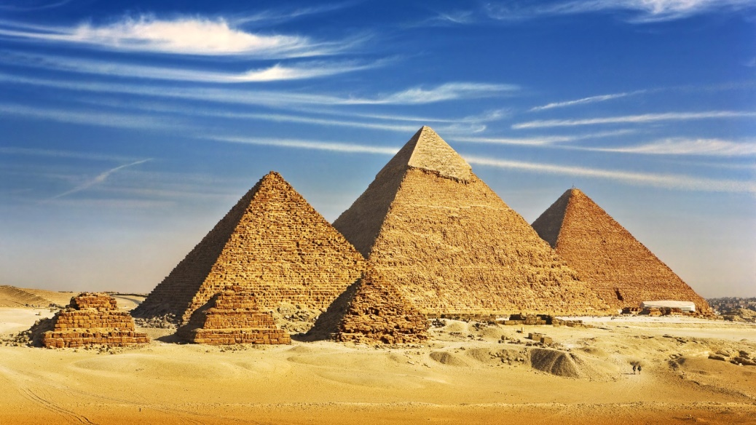
Adding Table and Picture
Serial No | Name | Favourite Activity
01 | Momin Khan | Drawing, Swimming And Reading
02 | Shaikat Bhuiyan | Dancing, Singing And Playing
03 | Apurba Debnath Ankon | Debating, Dancing and Watching Movies
04 | Tanmoy Chowhan | Writing , Gardening and Collecting

Slide 10
Adding Smart Chart
Child
Boy
Young
Mature
Old

Slide 11
Hyperlink
Adding Table and Picture
Animations
Adding Smart Chart

Slide 12

Slide Background

Slide 13
Action Button

Slide 14
End Of Presentation
Do you have any question ??

